Slide 1
HOT TOPIC
Digital Technology Hub for MIT

Slide 2
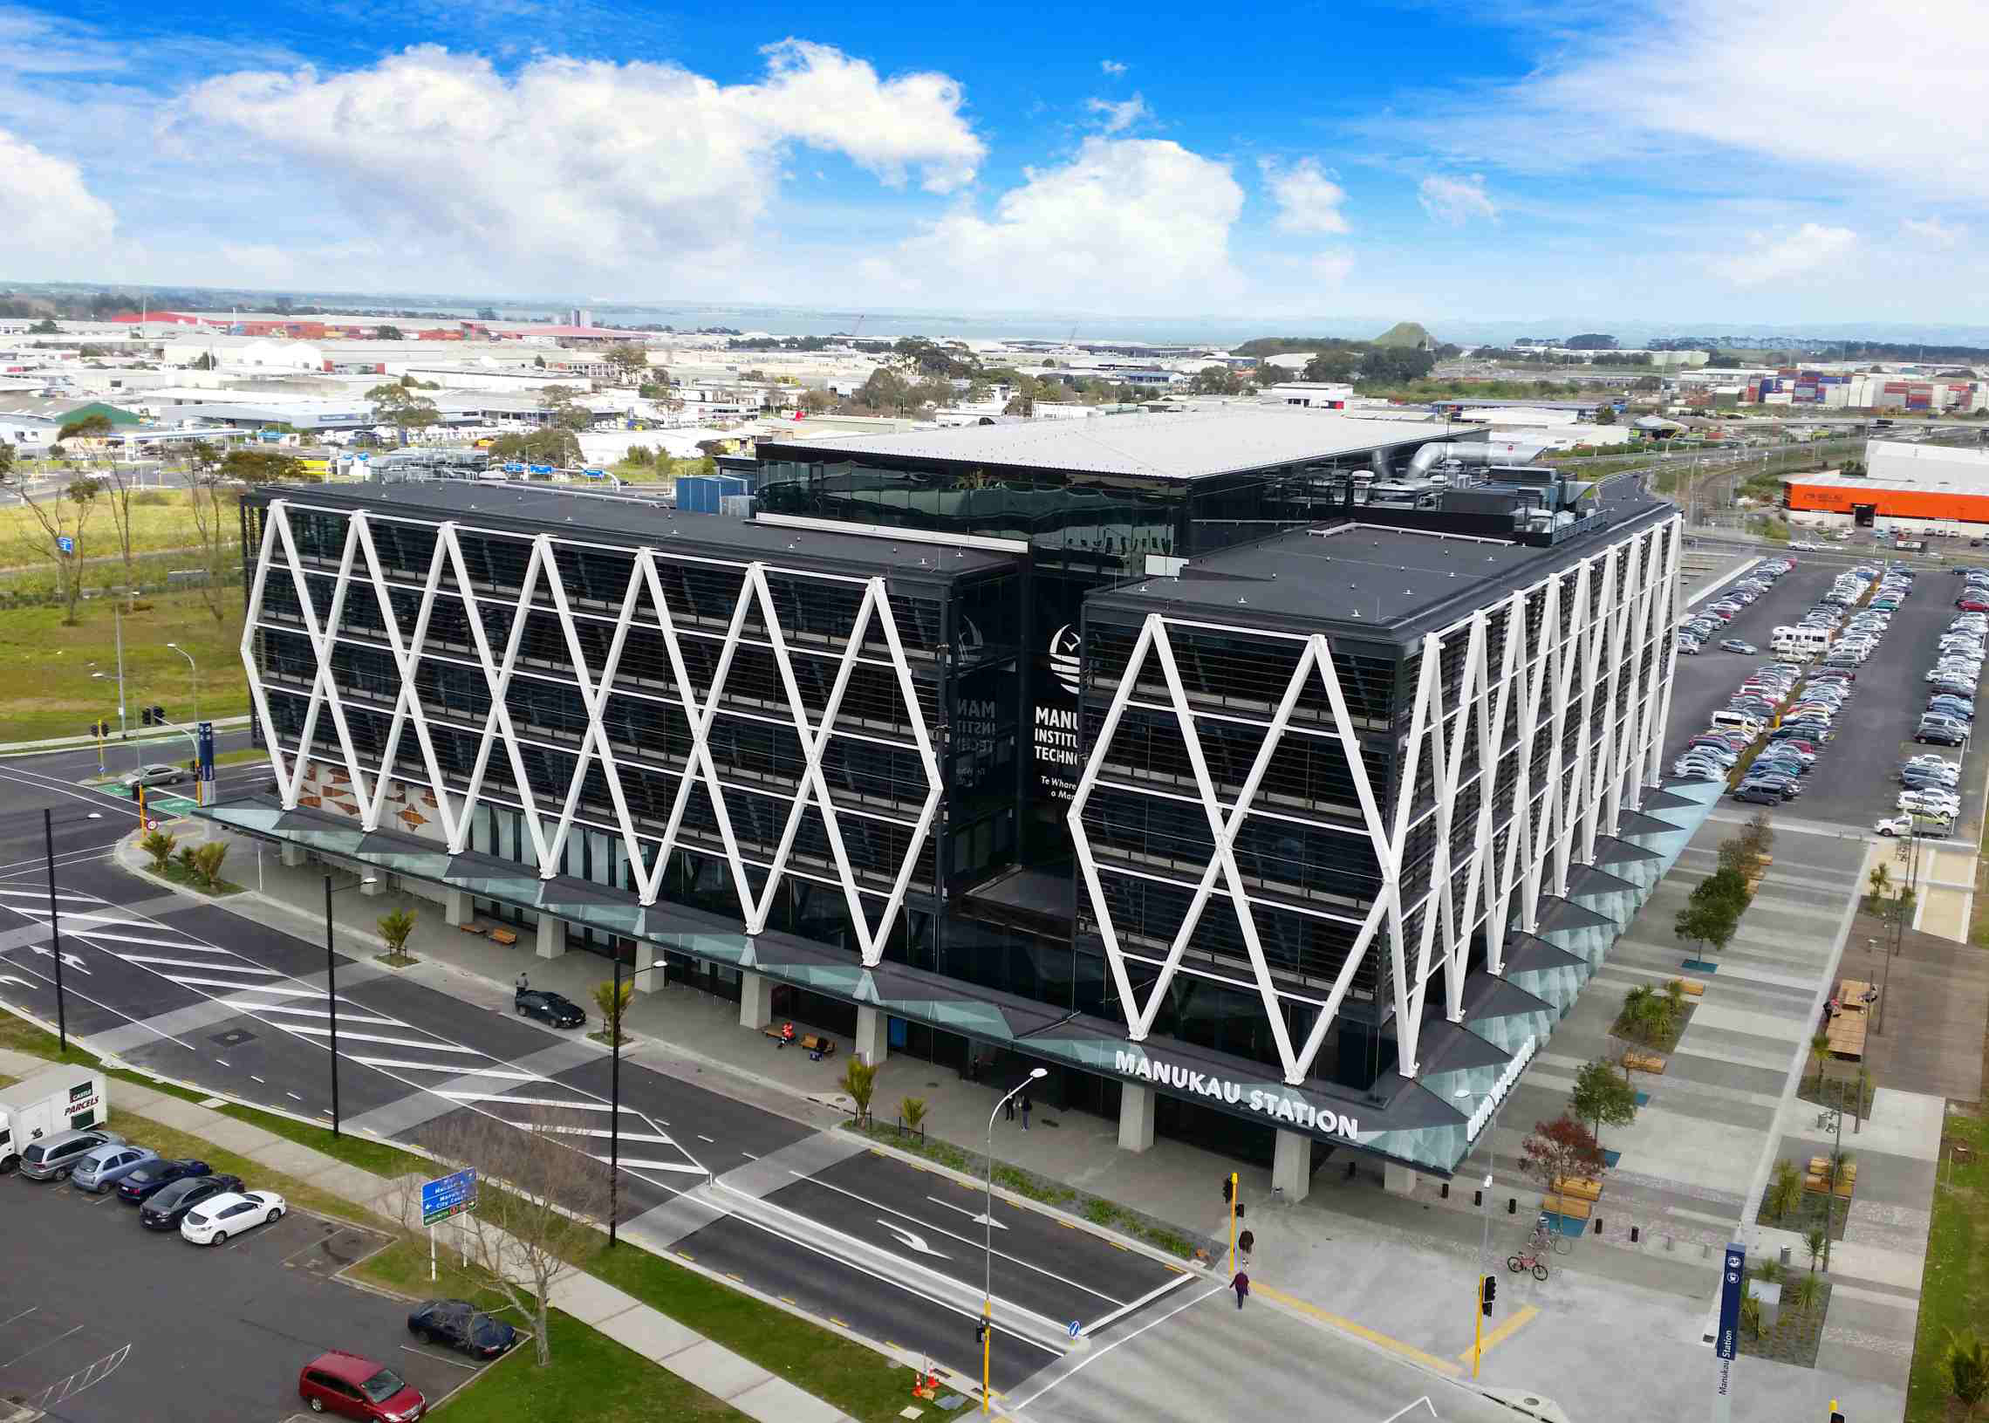
Topic Introduction
MIT is an Institution whereby young upcoming students come to study with a vision to approach/achieve a final goal.
Diploma
Bachelors Degree / Honours
Post Graduate Diploma
Masters
Image: http://www.syeint.com/index.php?m=product&f=view&productID=29

Slide 3

MOV Statement
Our project will be considered successful if the number of students viewing and using the website functionalities increases by 20%

Slide 4
ISSUES
Current Business and Information Technology web page isn’t made well and is out of date.
Not enough detailed information for the Majors.
Jumbled up timetable for the 3 Majors
Lack of lecturer’s background and information.

Slide 5
IDEA
Aim - Make webpage have more information available
Description of course and detailed info on units available
Refurbished timetable for the whole course
Availability of the classes
What you will learn and need for the job sector

Slide 6
Research Criteria
How will we do this:
Look at others - 4 USA , 2 Local
Compare to what MIT currently has
Document differences
Apply what we feel the MIT web page is missing
Research Question:
How can we create a new hub for MIT about digital technology to help current students and people looking at MIT to potentially enroll?

Slide 7


Literature Review
UCLA (University of California, Los Angeles):
-News (Technology)
-Events
-Detailed Descriptions on staff
Image: http://brand.ucla.edu/brand/digital/logo/
University of Auckland:
-Message from Dean
- Detailed information about courses
-Careers and opportunities for student
Image: https://www.library.auckland.ac.nz/

Slide 8
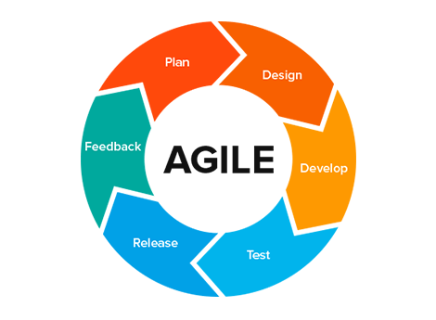
Research Approach
AGILE

Slide 9
Planning - Analysis
Based on research on Universities in Auckland and abroad. We found out and analysed:
Information on different courses provided
Information on which course is taught by which lecturer
Biography and a short blog on the lecturer
After studies predictions on job market
News on the evolving Technology in the world

Slide 10




What will be used
Languages:
HTML
SASS - Syntactically Awesome Stylesheet / CSS
Bootstrap
Jquery
Javascript
Programme:
WordPress

Slide 11
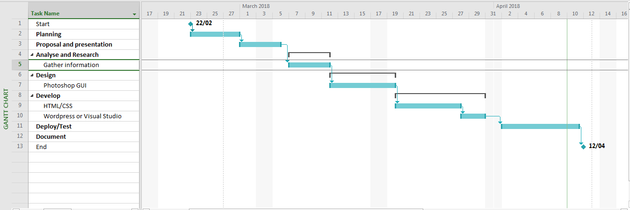
Gantt Chart

Slide 12
QUESTIONS?

